Slide 1
User-Centered Design

Slide 2
REVIEW
Activity: “Design for Betty” – From Persona to Prototype
Goal
You will practice user-centered design by creating solutions for a persona, then conduct a usability test with peers.
Notes:
‹#›

Slide 3
Step 1: Warm-Up
Present the persona “Betty” (from your slides: Warehouse Manager, limited computer training, slight right-hand restriction, dislikes late work, feels threatened by new systems).
“What challenges might Betty face with a new computer system?”
Capture ideas on the board (e.g., accessibility, training, work-life balance).
Notes:
‹#›

Slide 4
Step 2: Quick Design Challenge
Each group designs a low-fidelity prototype (sketches on paper) of a simple system feature Betty would use, e.g.:
Inventory lookup screen
Staff task dashboard
Delivery log entry form
Think like Betty (limited training, needs clarity, doesn’t like complex navigation).
Notes:
‹#›

Slide 5
Step 3: Peer Role-Play Usability Test
Groups swap prototypes.
One student role-plays Betty using the prototype.
The other group acts as observers.
The “Betty” student must try to complete a task (e.g., “Check how many boxes of screws are in stock”).
Observers record:
Where did Betty hesitate?
Did she understand what to do?
Was the interface accessible for her (considering her physical limitation)?
Notes:
‹#›

Slide 6
Step 4: Debrief & Reflection
Groups report what problems Betty faced and what design changes they’d make.
Discuss how usability testing revealed issues that weren’t obvious during design.
Wrap up with the lesson:
Designing for users means stepping into their shoes, testing with them, and iterating.
Notes:
‹#›

Slide 7
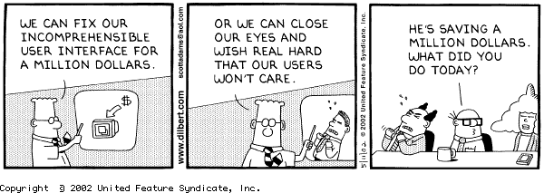

Slide 8
What is User-Centered Design?
An approach to UI development and system development.
Focuses on understanding:
Users, and
Their goals and tasks, and
The environment (physical, organizational, social)
Pay attention to these throughout development
Notes:
‹#›

Slide 9
ISO on User-centered Design
ISO 13407 describes human-centered design processes for interactive systems
Principles of human-centered design:
Active involvement of users
Appropriate allocation of function between user and system
Iteration of design solutions
Multidisciplinary design teams
Notes:
‹#›

Slide 10
ISO on User-centered Design (2)
Essential activities in human-centered design:
Understand and specify the context of use
Specify the user and organizational requirements
Produce design solutions (prototypes)
Evaluate designs with users against requirements
Notes:
‹#›

Slide 11
What is a user-centered approach?
User-centered approach is based on:
Early focus on users and tasks: directly studying cognitive, behavioral, anthropomorphic & attitudinal characteristics
Empirical measurement: users’ reactions and performance to scenarios, manuals, simulations & prototypes are observed, recorded and analysed
Iterative design: when problems are found in user testing, fix them and carry out more tests

Slide 12
Four basic activities
There are four basic activities in Interaction Design:
1. Identifying needs and establishing requirements
2. Developing alternative designs
3. Building interactive versions of the designs
4. Evaluating designs

Slide 13
Some practical issues
Who are the users?
What are ‘needs’?

Slide 14
Who are the users/stakeholders?
Not as obvious as you think:
those who interact directly with the product
those who manage direct users
those who receive output from the product
those who make the purchasing decision
those who use competitor’s products
Three categories of user (Eason, 1987):
primary: frequent hands-on
secondary: occasional or via someone else
tertiary: affected by its introduction, or will influence its purchase

Slide 15
What are the users’ capabilities?
Individual differences:
size of hands may affect the size and positioning of input buttons
motor abilities may affect the suitability of certain input and output devices
height if designing a physical kiosk
strength - a child’s toy requires little strength to operate, but greater strength to change batteries
disabilities (e.g. sight, hearing, dexterity)
abilities also vary according to context

Slide 16
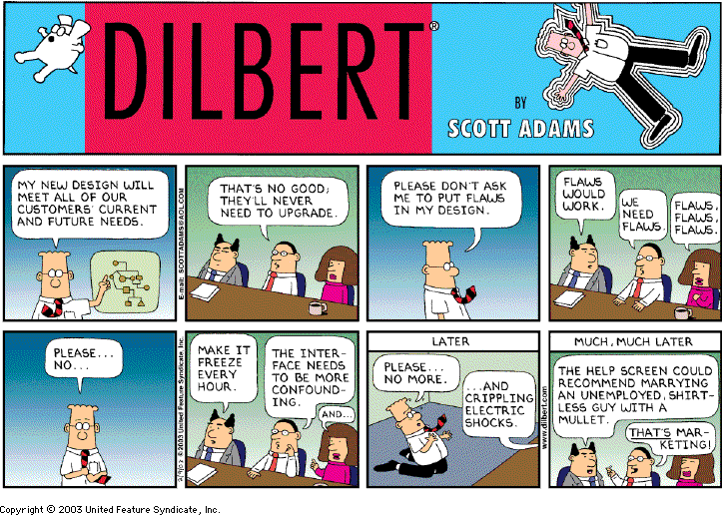
Users’ needs

Slide 17
What are ‘needs’?
Users rarely know what is possible
Users can’t tell you what they ‘need’ to help them achieve their goals
Instead, look at existing tasks:
their context
what information do they require?
who collaborates to achieve the task?
why is the task achieved the way it is?
Envisioned tasks:
can be rooted in existing behaviour
can be described as future scenarios

Slide 18
Brief overview of common methods to gather user data
Interviews
Questionnaires
Observation
Choosing and combining techniques

Slide 19
Interviews
Unstructured - are not directed by a script. Rich but not replicable.
Structured - are tightly scripted, a questionnaire delivered verbally. Replicable but may lack richness.
Semi-structured - guided by a script but interesting issues can be explored in more depth. Can provide a good balance between richness and replicability.

Slide 20
Interview questions
Two types:
‘closed questions’ have a predetermined answer format, e.g., ‘yes’ or ‘no’
‘open questions’ do not have a predetermined format
Closed questions are easier to analyze
Avoid:
Long questions
Compound sentences - split them into two
Jargon and language that the interviewee may not understand
Leading questions that make assumptions e.g., why do you like …?
Unconscious biases e.g., gender stereotypes

Slide 21
Enriching the interview process
Props - devices for prompting interviewee, e.g., a prototype, scenario

Slide 22
Contextual Inquiry
An approach to ethnographic study. Often conducted as an apprenticeship where user is expert, designer is apprentice
A form of interview, but
at users’ workplace (workstation)
2 to 3 hours long
Four main principles:
Context: see workplace & what happens
Partnership: user and developer collaborate
Interpretation: observations interpreted by user and developer together
Focus: project focus to understand what to look for

Slide 23
Questionnaires
Questions can be closed or open
Closed questions are easier to analyze, and may be done by computer
Can be administered to large populations
Paper, email and the web used for dissemination
Sampling can be a problem when the size of a population is unknown as is common online

Slide 24
Questionnaire design
The impact of a question can be influenced by question order.
Do you need different versions of the questionnaire for different populations?
Provide clear instructions on how to complete the questionnaire.
Strike a balance between using white space and keeping the questionnaire compact.
Decide on whether phrases will all be positive, all negative or mixed.

Slide 25
Advantages of online questionnaires
Responses are usually received quickly
No copying and postage costs
Data can be collected in database for analysis
Time required for data analysis is reduced
Errors can be corrected easily

Slide 26
Problems with online questionnaires
Sampling is problematic if population size is unknown
Preventing individuals from responding more than once
Individuals have also been known to change questions in email questionnaires

Slide 27
Observation
Direct observation in the field
Structuring frameworks
Degree of participation (insider or outsider)
Ethnography
Direct observation in controlled environments
Indirect observation: tracking users’ activities
Diaries
Interaction logging

Slide 28
Structuring frameworks to guide observation
- The person. Who? - The place. Where? - The thing. What?
The Goetz and LeCompte (1984) framework: - Who is present? - What is their role? - What is happening? - When does the activity occur? - Where is it happening? - Why is it happening? - How is the activity organized?

Slide 29
Ethnography (1)
Ethnography is a philosophy with a set of techniques that include participant observation and interviews
Debate about differences between participant observation and ethnography
Ethnographers immerse themselves in the culture that they study
A researcher’s degree of participation can vary along a scale from ‘outside’ to ‘inside’
Analyzing video and data logs can be time-consuming
Collections of comments, incidents, and artifacts are made

Slide 30
Ethnography (2)
Co-operation of people being observed is required
Informants are useful
Data analysis is continuous
Interpretivist technique
Questions get refined as understanding grows
Reports usually contain examples

Slide 31
Direct observation in a controlled setting
Think-aloud technique
Indirect observation
Diaries
Interaction logs

Slide 32
Choosing and combining techniques
Depends on
The focus of the study
The participants involved
The nature of the technique
The resources available

